Slide 1
Encrypting and Decrypting Data
By : Salman masood

Slide 2
Introduction to Encryption & Decryption
Encryption and decryption are cryptographic techniques to secure data in storage and in transit. Encryption is the process of transforming data into a secured unreadable format. This data, being in the encrypted form, cannot be read and understood by any user or application without being converted into the original format. Transformation of this encrypted data into the original format is known as decryption.

Slide 3
Introducing Cryptography and Encryption
All organizations need to handle sensitive data. This data can be either present in storage or may be exchanged between different entities within and outside the organization over a network. As an example, consider Steve, who is the CEO of a company. Steve while travelling needs to access performance appraisal reports of the top management of the company. These reports contain data that are confidential and are stored in the company’s server. Such data is often prone to misuse either intentionally with malicious intent or unintentionally. To avoid such misuse, there should be some security mechanism that can ensure confidentiality and integrity of data. Cryptography is a security mechanism to ensure data confidentiality and integrity.

Slide 4
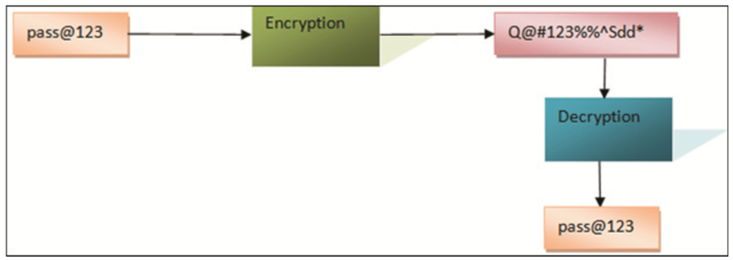
Encryption Basics
Consider a scenario where User A transmits sensitive data to User B. The transmission needs to be confidential to ensure that even if a third party obtains the data, the data is incomprehensible. In addition, User B before using the data must be sure about the integrity of the data, which means that User B must be sure that the data has not been modified in transit. Also, User B must be able to authenticate that the data is actually been send by User A. On the other hand, after sending the data, User A must not be able to deny sending the data to User B.

Slide 5
Symmetric Encryption
Symmetric encryption, or secret key encryption, uses a single key, known as the secret key both to encrypt and decrypt data. The following steps outline an example usage of symmetric encryption:
User A uses a secret key to encrypt a plain text to cipher text.
User A shares the cipher text and the secret key with User B.
User B uses the secret key to decrypt the cipher text back to the original plain text.
Note - To make symmetric encryption more secure, an Initialization Vector (IV) can be used with the secret key. An IV is a random number that generates different sequence of encrypted text for identical sequence of text present in the plain text. When you use an IV with a key to symmetrically encrypt data, you will need the same IV and key to decrypt data.

Slide 6
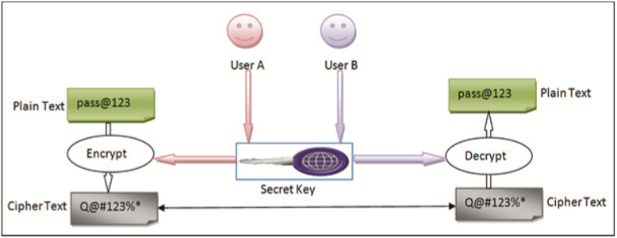

Slide 7
Asymmetric Encryption
Asymmetric encryption uses a pair of public and private key to encrypt and decrypt data. The following steps outline an example usage of asymmetric encryption:
User A generates a public and private key pair. User A shares the public key with User B.
User B uses the public key to encrypt a plain text to cipher text.
User A uses the private key to decrypt the cipher text back to the original plain text.

Slide 8
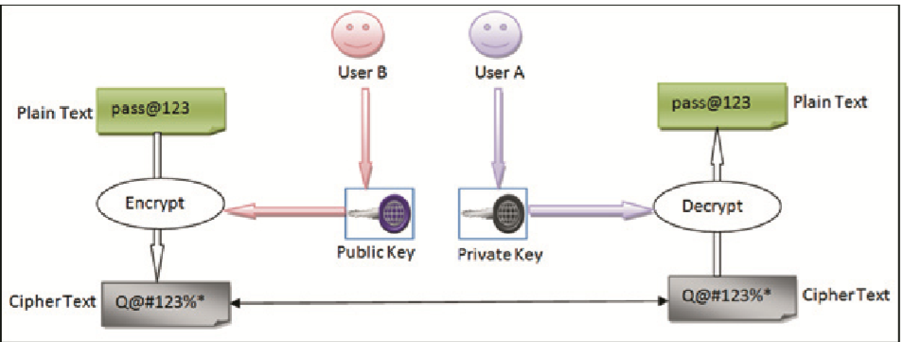

Slide 9
Performing Symmetric Encryption
You need to use one of the symmetric encryption implementation classes of the .NET Framework to perform symmetric encryption.
When you use the default constructor of the symmetric encryption classes, such as RijndaelManaged and AesManaged, a key and IV are automatically generated. The generated key and the IV can be accessed as byte arrays using the Key and IV properties of the encryption class.
Check : folder name “Symmetric”

Slide 10
Generate Keys By Method
The symmetric encryption classes, such as RijndaelManaged also provide the GenerateKey() and GenerateIV() methods that you can use to generate keys and Iv.
Steps to write code :
Creates a RijndaelManaged object and calls the GenerateKey() and GenerateIV() methods to generate a key and an IV. The Key and the IV properties are then accessed and printed as strings using the default encoding to the console

Slide 11
Encrypting Data
The symmetric encryption classes of the .NET Framework provides the CreateEncryptor() method that returns an object of the ICryptoTransform interface. The ICryptoTransform object is responsible for transforming the data based on the algorithm of the encryption class. Once you have obtained an ICryptoTransform object, you can use the CryptoStream class to perform encryption. The CryptoStream class acts as a wrapper of a stream-derived class, such as FileStream, MemoryStream, and NetworkStream. A CryptoStream object operates in one of the following two modes defined by the CryptoStreamMode enumeration:

Slide 12
Performing Asymmetric Encryption
You can use the RSACrypto ServiceProvider class of the System.Security.Cryptography namespace to perform asymmetric encryption.

Slide 13
Encrypting Data
To encrypt data, you need to create a new instance of the RSACryptoServiceProvider class and call the ImportParameters() method to initialize the instance with the public key information exported to an RSAParameters structure.

